Slide 1



BLE-Mesh based Smart Switch for
HOME AUTOMATION
Team Smart Holmes
2022
TEAM ID: HA-220502

Slide 2

The Problem
Problem
Creating self aware smart home network using advanced smart switches
Challenges
Replacing traditional switches with our product
Energy efficient solution for communication between multiple switch boards
Reducing power consumption of devices using inbuilt occupancy detection
Making these network of switches secure and affordable
2022
Team ID: HA-220502

Slide 3
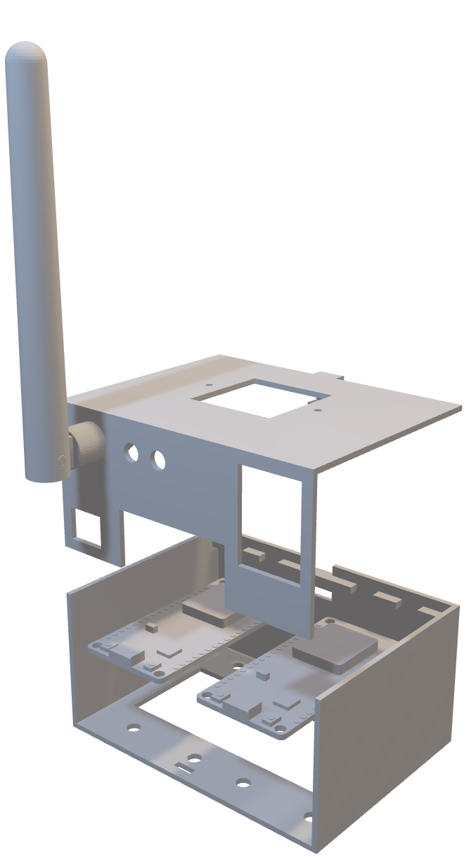
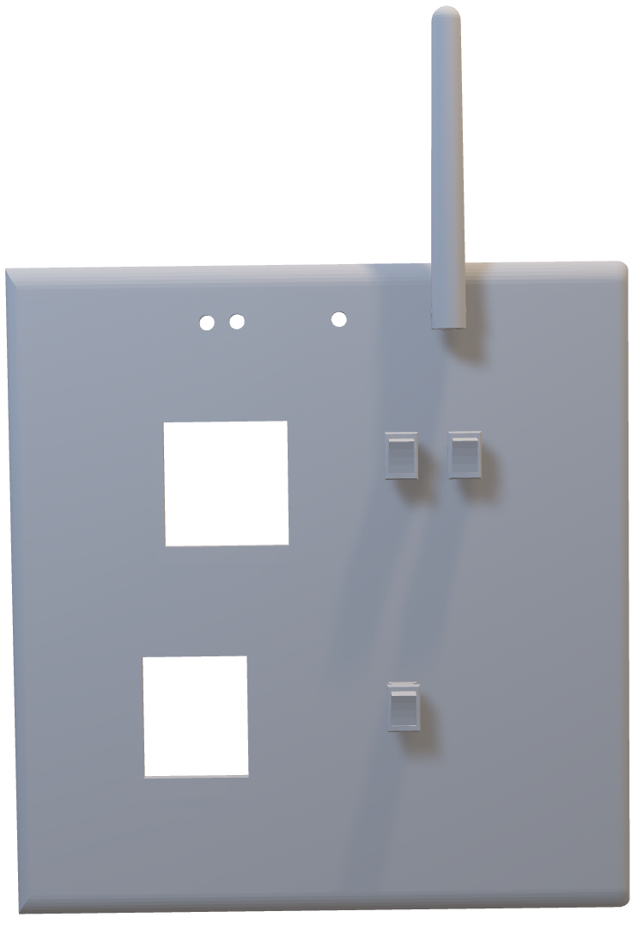
THE SOLUTION
Proposed
Product
Prototype
2022
Team Id: HA-220502

Slide 4
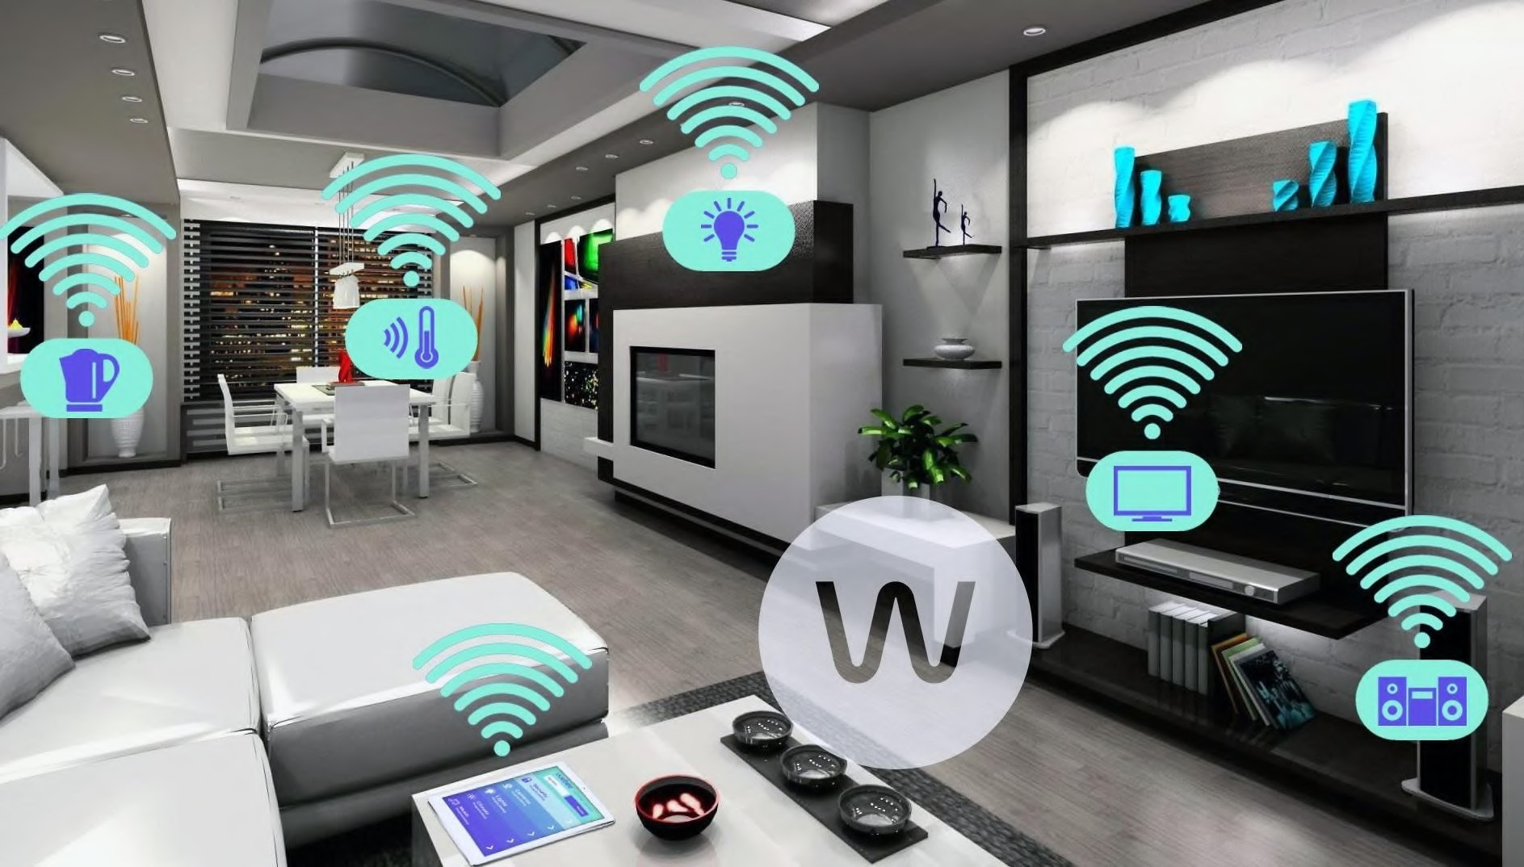

SMART SWITCHES
Make dumb devices smart and power efficient
Smart switches: Our designed smart switch can replaced existing household switches as it fits in the same switch size
It is based on BLE Mesh protocol.
The BLE Mesh protocol uses very low power compared to other protocols such as Zigbee and Wi-Fi
We have faster and reliable communication between nodes as it is a local network.
•
Team ID: HA-220502

Slide 5

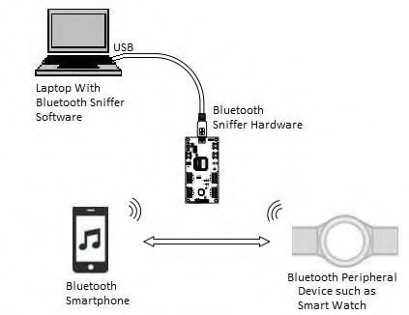
OCCUPANCY DETECTION
Detect RSSI values of BLE devices such as smart watches to know the users location inside houses
Use PIR sensors to detect movement of users inside the house
With the help of all this data we can turn on/off specific lights or create scenes in the room to save energy whenever lights are not required
Team ID: HA-220502

Slide 6
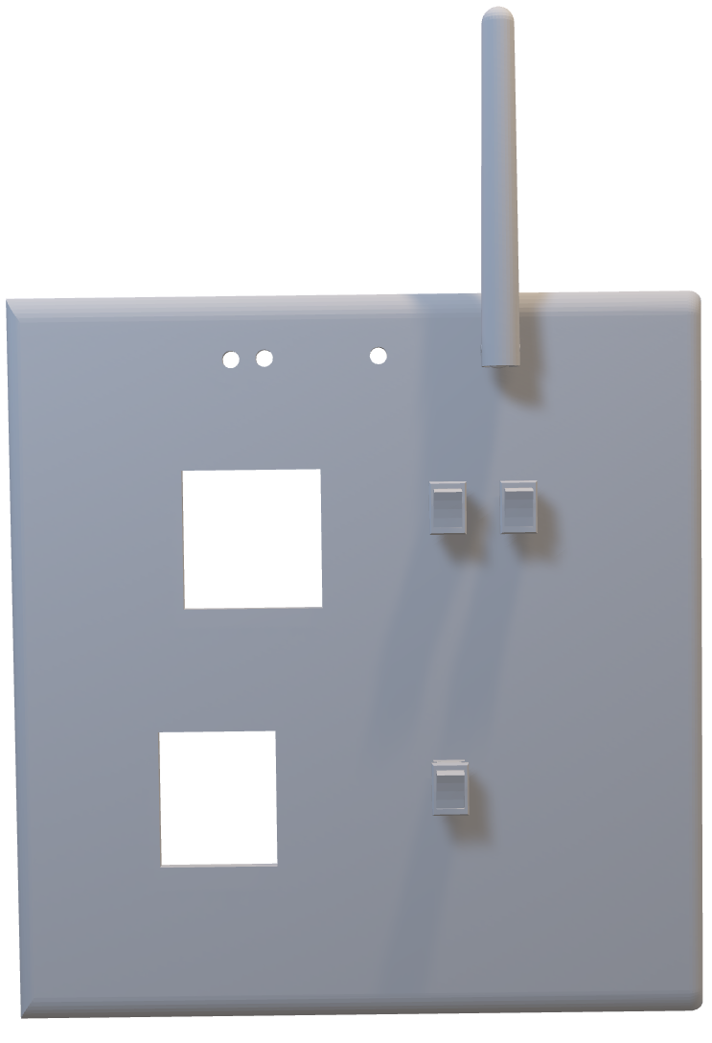
Product Value
On/Off Indicator
Number one
Smart features for power saving
LDR
Number two
Faster and reliable communication due to mesh topology
IR Blaster
Switches
Switches
Fan Regulator
Number three
Modularity and Scalability
Socket
Team ID: HA-220502

Slide 7
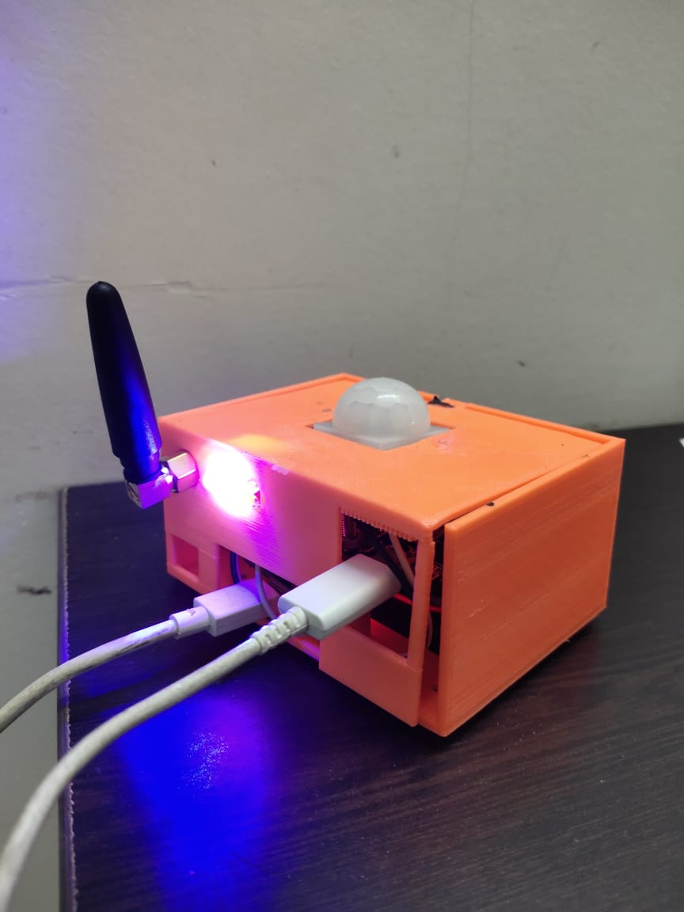
Smart Power Saving Features
Low power nodes reduce power consumption by activating sleep mode when not in use.
This allows for energy saving and is highly useful in battery powered applications.
The system accomplishes this by occupancy detection techniques mentioned above.
Controlling Light Intensity using BLE Sniffer:
Use BLE sniffer to detect proximity of registered BLE device and accordingly set On/Off state or intensity level for the lights.
Control using LDR based detection:
☐
Detect luminous intensity of the room using LDR and adjust intensity of all nodes in the group based on this value.
Team ID: HA-220502

Slide 8
Fast, Secure & Reliable Communication
BLE uses two types of key for encrypting the messages sent in the network
BLE technology uses frequency hopping techniques to ensure secure transmission of messages.
A fast and reliable data rate of 2 Mbps is achievable using BLE 5.1
There is no cloud backend necessary, hence, your data is always on the local network, although Wi-Fi connectivity can be implemented for specific nodes.
Modularity and Scalability
Additional nodes are easy to set up and new nodes can be easily inserted and configured into the network, thus making the system scalable
Each smart switch is a self sustained sub system
We can also override the wireless controls using the onboard switches like traditional systems
Our product is available in various configurations depending on the number of switches requires without having a large cost difference.
Team ID: HA-220502

Slide 9


Usability • Flexibility • Reliability
Product Advantages:
Scalable • Cost-effective
Team ID: HA-220502

Slide 10
Comparison Study
BLE | Wi-Fi | Zigbee mesh
High Security & Data Privacy | Low Data Security | Least Secure Network
High Data rate(2Mbps) | Fastest Data rate | Lowest data rate
High Power Efficiency | Very low Power efficiency | High Power Efficiency
Low Cost | Expensive | Expensive
Starting Price: Rs. 700 for 1 switch Additional Rs. 50 per switch | 2 switches: Rs. 2000 5 switches: Rs 5000 9 switches Rs 7000 | 6 switches: Rs 6000
Team ID: HA-220502

Slide 11
Target Audience
This product is targeted to people who want to adopt IoT devices into their daily life without the need to replace their existing appliances, i.e., make dumb devices smart.
This product is also targeted to people who have already adapted various smart IoT devices but are frustrated due to using various apps and protocols of depending on the vendor’s implementation.
Villa/Mansion owners can use the product to save over 15-20% of their electricity bills.
People in rural areas where Wi-Fi services are not always present or reliable can use this product as BLE systems will be compatible with their mobile phones.
Team ID: HA-220502

Slide 12
THANK YOU
SIDDHARTH GAJARMAL SHREYAS DESHPANDE TIRTHESH SOHANI
Team Id: HA-220502

